Slide 1
E-Medicare
RLL Project - Group 06

Slide 2
Git Repo & Team Members :
Git Repository: https://github.com/Arbaazshibar/RRL-Project-Emedicare.git
Arbaaz Shibargatti
Akula Chaitanya
Anil Kumar
Bathala Tejasree
Bussa Manasa
Asmath Hazeena A
Charan kumar S
Aditya Gaurav

Slide 3
Abstract
The purpose of E-Medicare application is to automate the existing manual system by the help of computerized equipment's and full-fledged computer software, fulfilling their requirements, so that their valuable data can be stored for a longer period with easy accessing and manipulation of the same.
E-Medicare System, as described above, can lead to error free, secure, reliable and fast management system.

Slide 4
Introduction
The main aim of this project is to develop an online web portal that can handle Medicine booking. In recent times, mobile healthcare apps become more trending due to pandemic crisis. People have reduced to leave their home in the aftermath of the pandemic to purchase even basic commodities. Online medicine delivery apps allow for delivery at your doorstep.
In this, users can choose a medicine section of their choices and go through all the items that the system provides. Users can then select the desired drug items, add them to cart and then proceed to payment.
Our system solves the problems of going for searching medicines and saves transport cost. We are ensuring the safe and reliable process of purchasing medicines.

Slide 5
Proposed System
The proposed medical Booking Store System will completely Revolutionize the industry.
Searching of products, order placing, billing and product stock can be maintained by a single click.
The payment of the order can also be done by credit cards

Slide 6
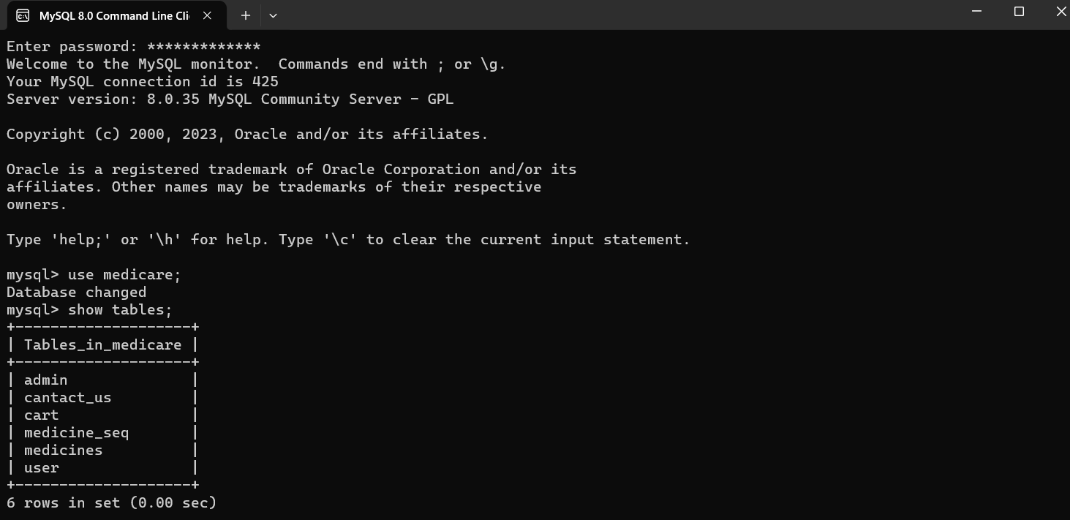
Database Schema

Slide 7
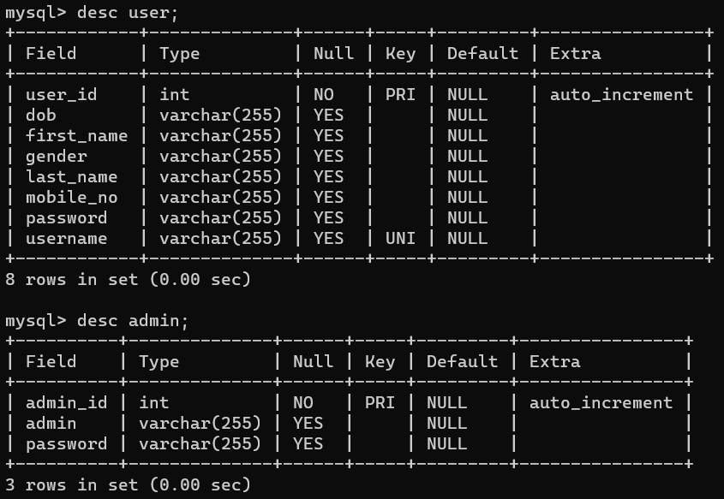
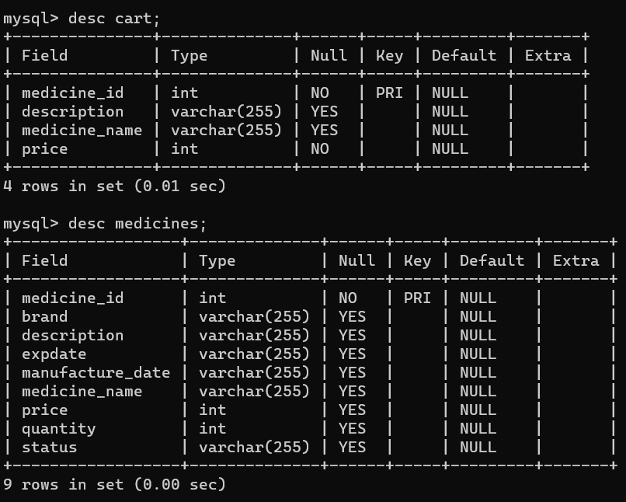
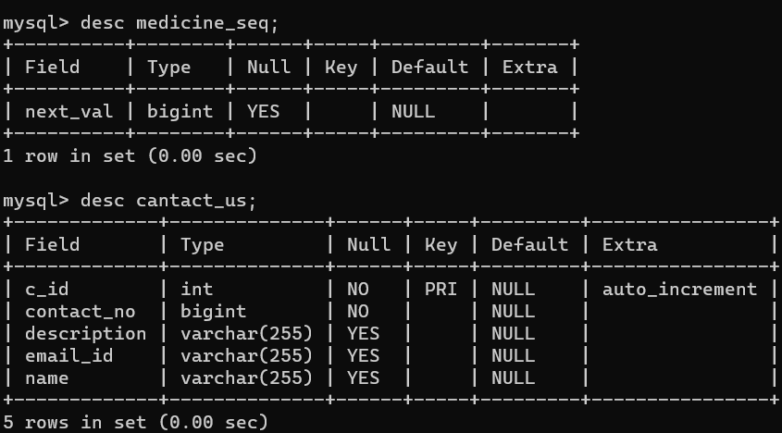

Slide 8
Technology Used
HTML : Page layout has been designed in HTML.
CSS : CSS has been used for all the designing part.
Java : All the business logic has been written in Java.
Angular CLI : Command-line interface tool that we use to initialize.
MySQL : MySQL database has been used as database for the project.
Hibernate : Used for object-table mapping.
Spring-boot : Server side setup.
Tomcat : Server.

Slide 9
System Overview:
The “E-Medicare” should support basic functionalities for all below listed users
Login Module: Used for managing the login details.
Users Module: Used for managing the users of the system.
Admin Module: Used for managing. medicine details and user information.
Medicine Module: Used for managing the Medicine details.
Contact_us: Used if customer is having complaints.
Cart Module: Used for managing the details of Cart.
Billing Module: Used for managing the details of Payment. add update module…

Slide 10
Admin Authentication & Authorization
Authentication:
Any end-user should be authenticated using a unique username and password.
Authorization:
The operations supported and allowed would be based on the user type. For example,Administrator has the rights to add product information and view customer details. He can also view order detail and purchase details of a medicines. Whereas User/Buyer has a right to Add, Remove and Clear all the products from cart

Slide 11
Functional Flow
Admin
DES Application
HTTP /GET
HTTP Response
Database
User
GUI
Server

Slide 12
Environment
Server – Apache Tomcat 10.0
Database – MySQL
My SQL J Connector
Node Version 20.11.0
Angular CLI
JDK 17
Eclipse IDE or Spring Tool Suite

Slide 13
Case Diagram
Add/Delete/Update
Medicine details
View all Medicines and
Own cart Medicines
Admin
User
Purchase Medicines
View all Medicines and
Users

Slide 14
Unit Testing:
JUnit is a unit testing framework for Java programming language. It plays a crucial role test-driven development, and is a family of unit testing frameworks collectively known as xUnit.
Features of JUnit:· J
Unit is an open source framework, which is used for writing and running tests.
Provides annotations to identify test methods.
Provides assertions for testing expected results.

Slide 15
Advantages
Cost Efficient
Easy Secured payments.
User can view different categories of product of different pharma company .
Saves Money.
Diminishes Medical Wastes.
It has a user friendly interface.

Slide 16
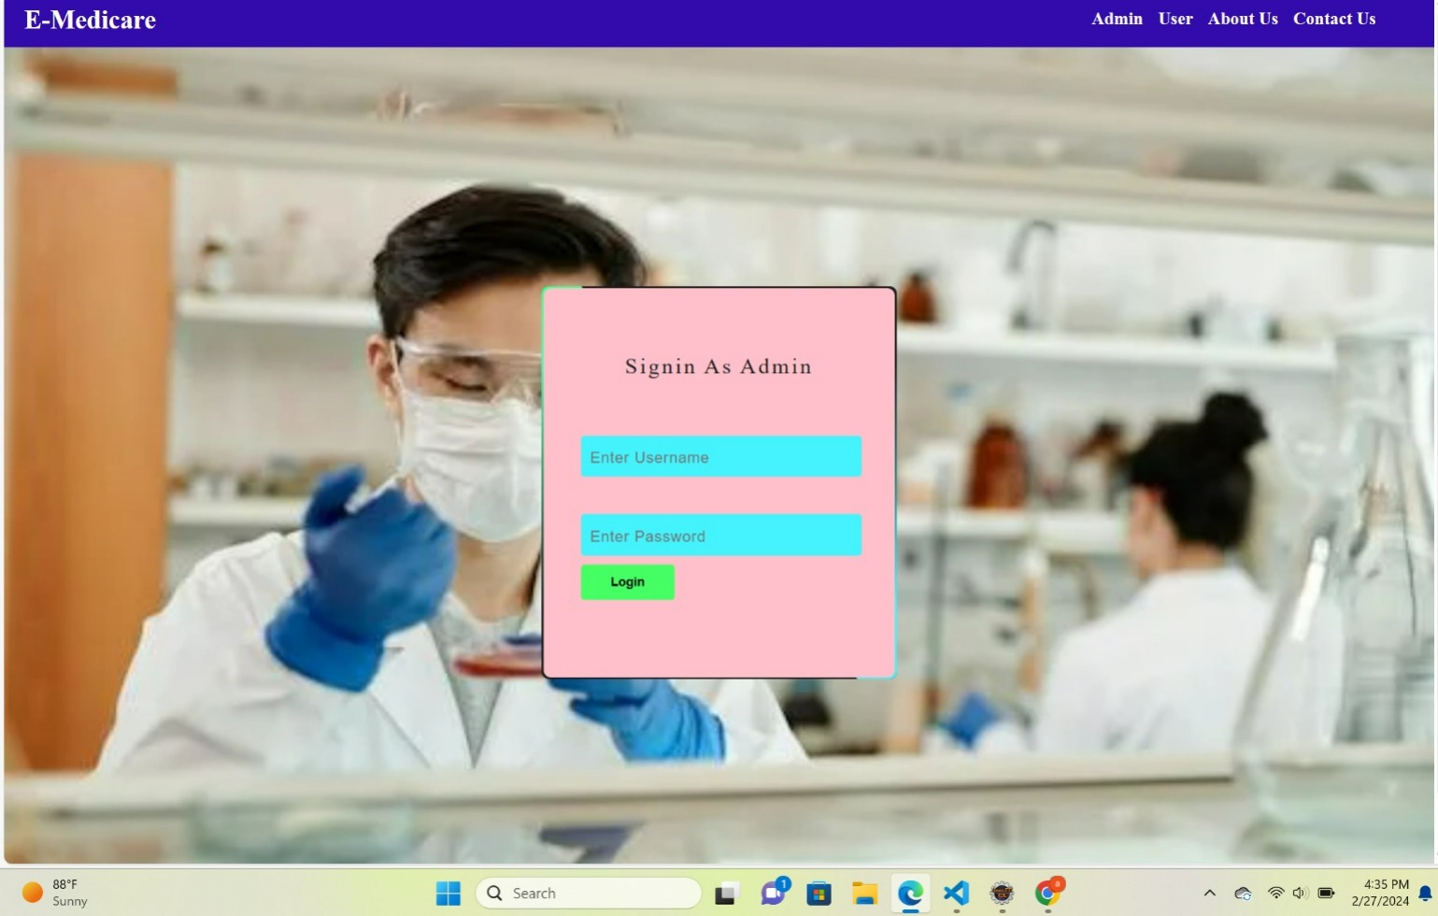
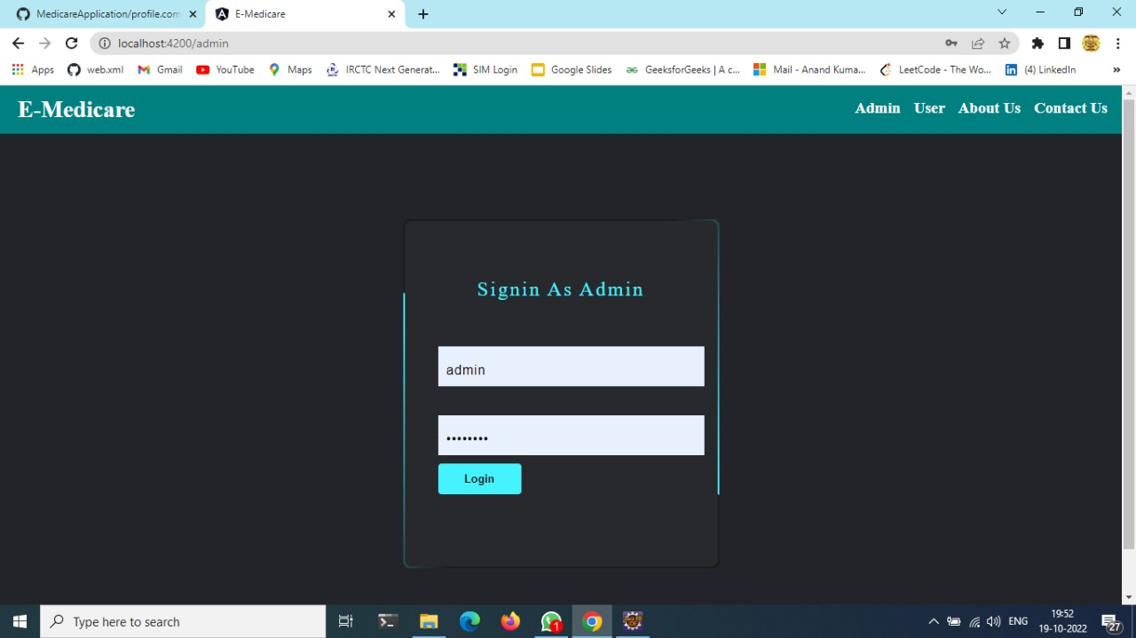
Admin login

Slide 17
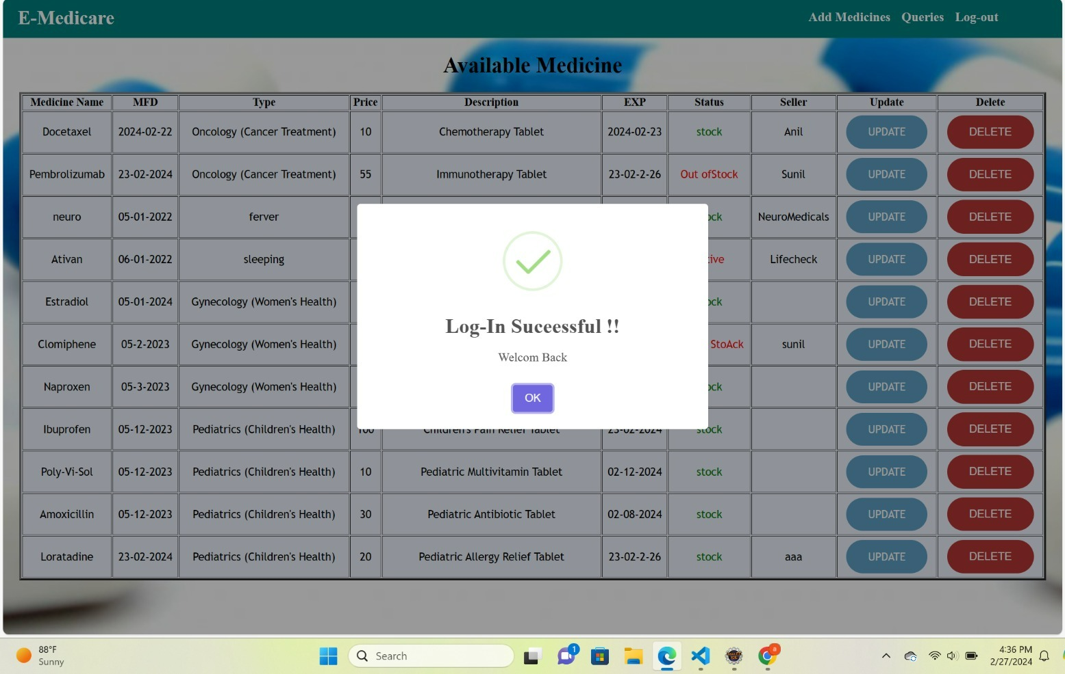
Admin Login Success

Slide 18
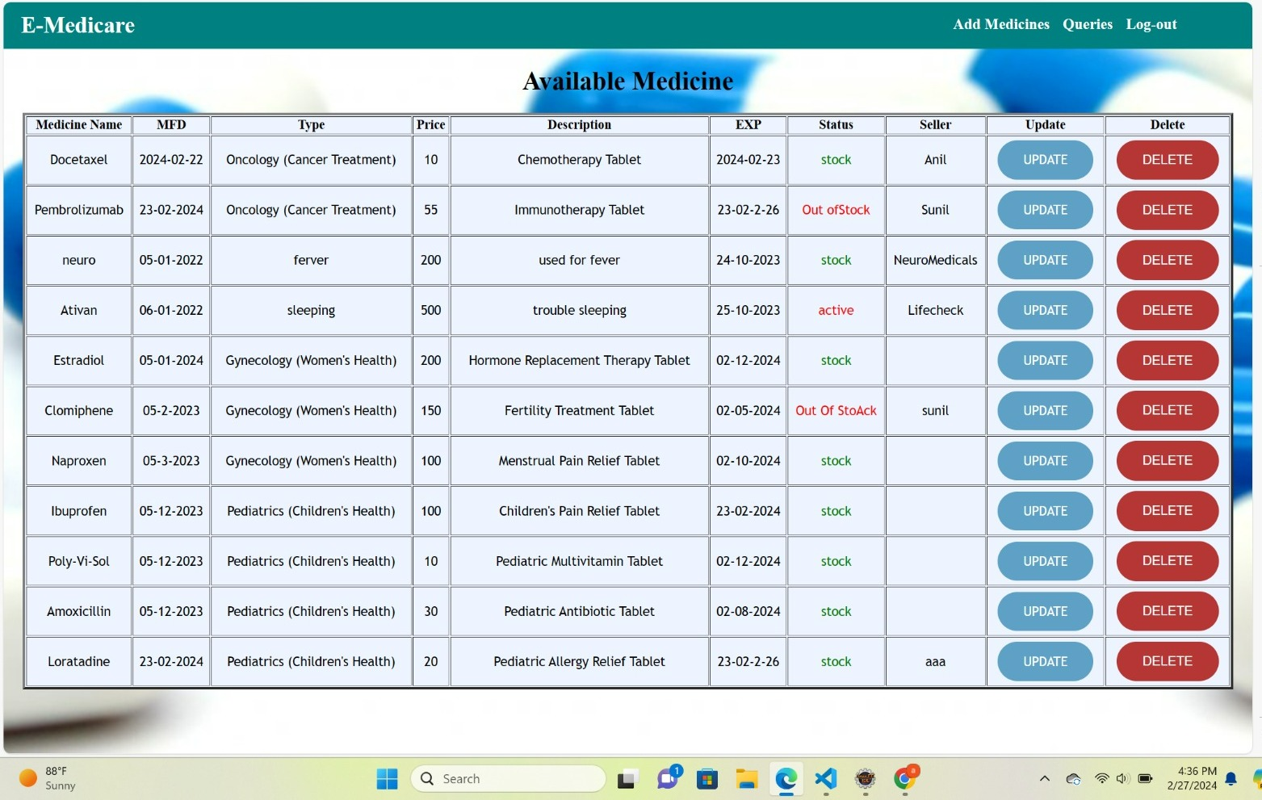
Admin Dashboard

Slide 19
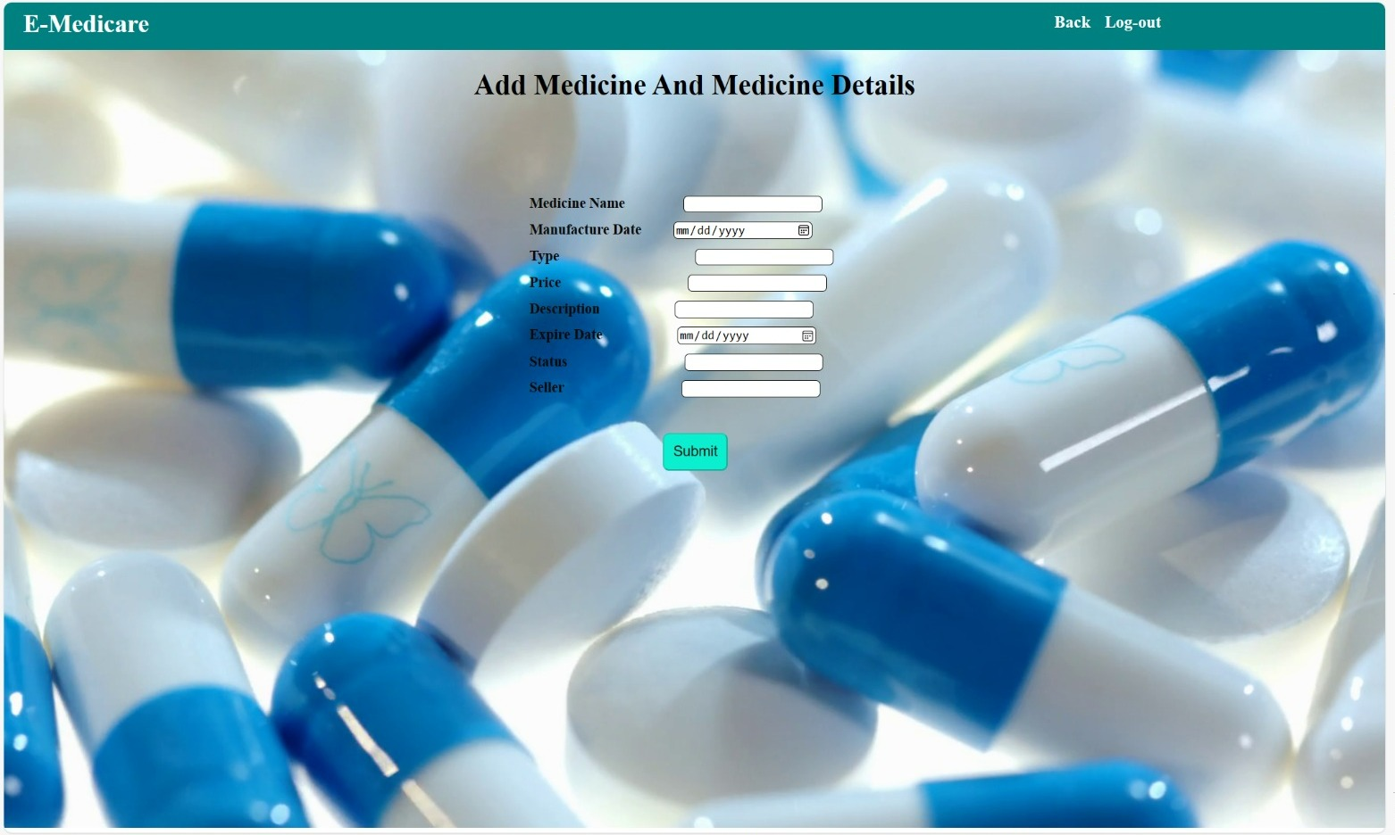
Add Medicine

Slide 20
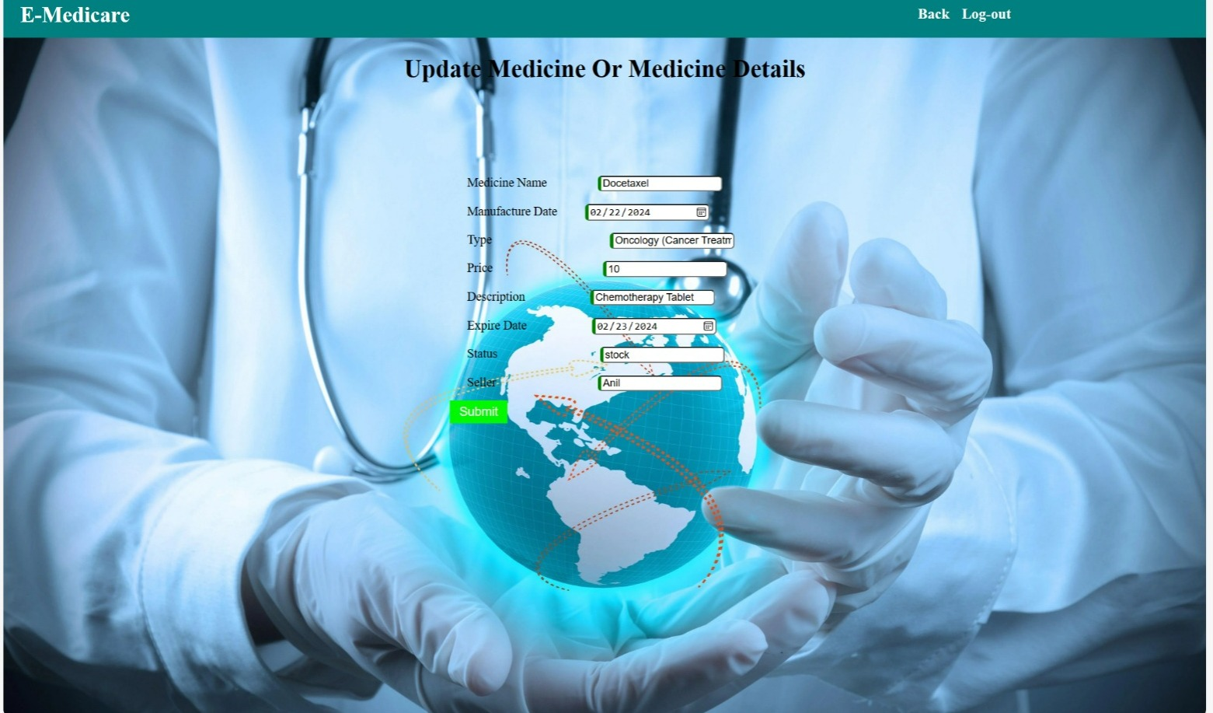
Change the password

Slide 21
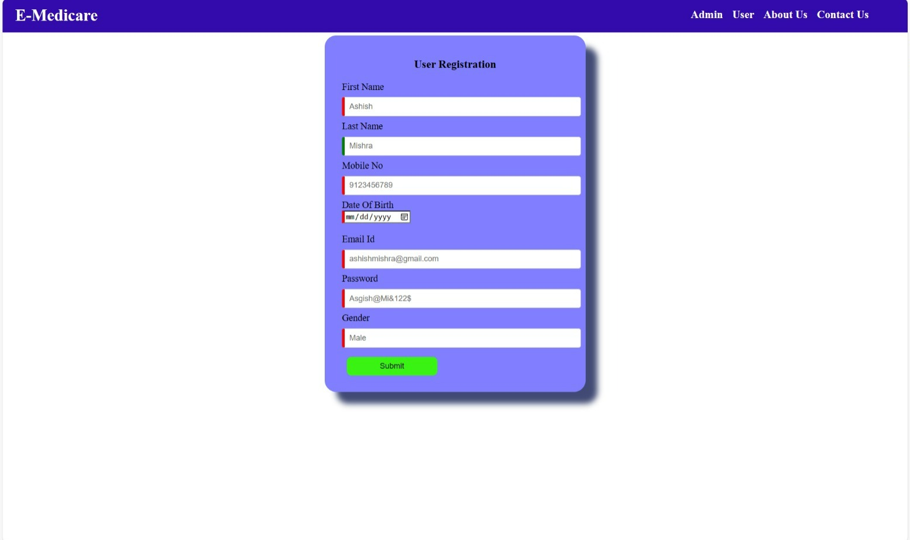
User Regestration

Slide 22
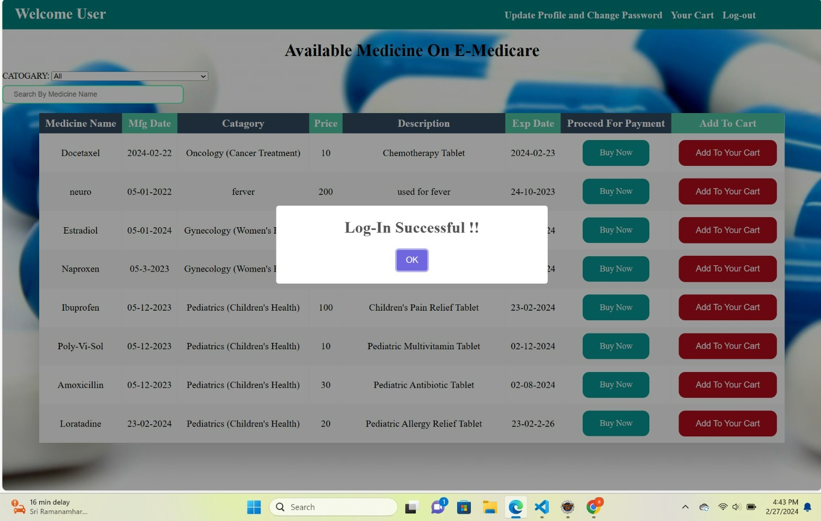
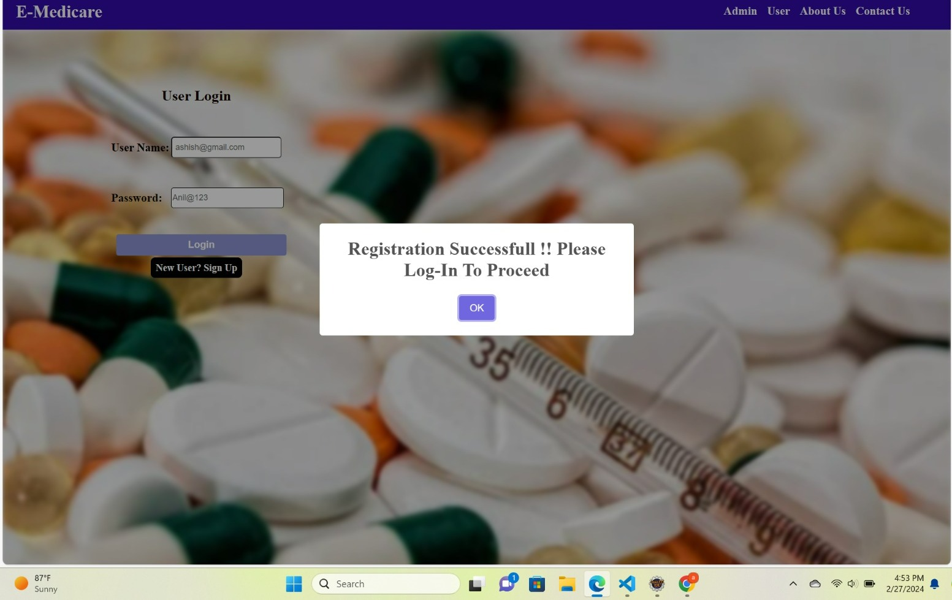
User Registration Success

Slide 23
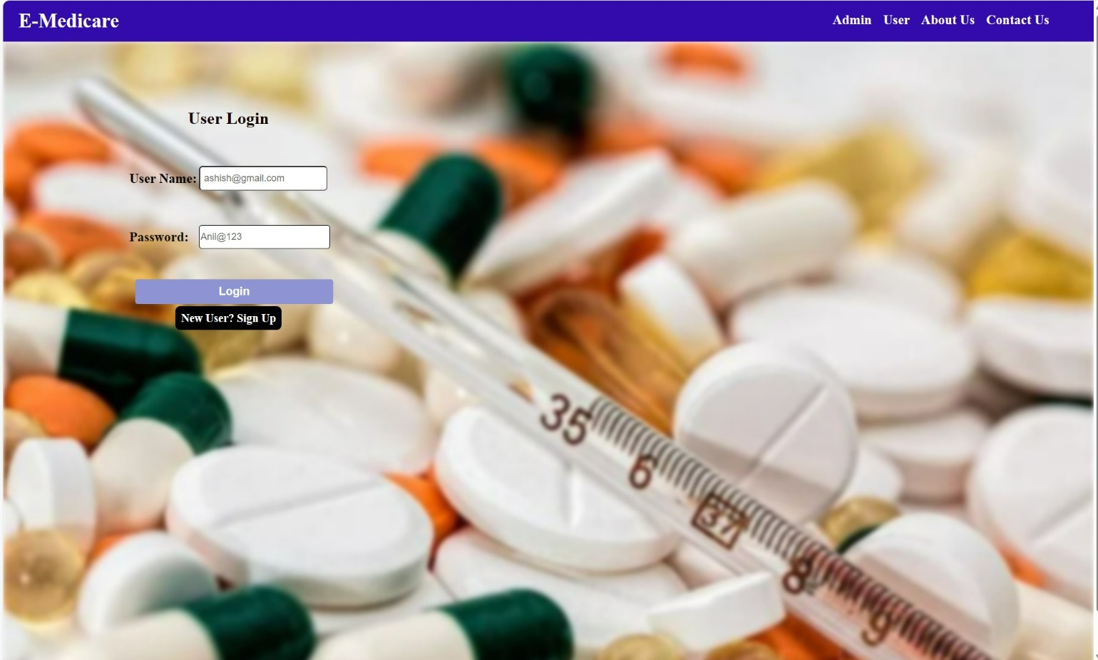
User Login

Slide 24
User Login Success

Slide 25
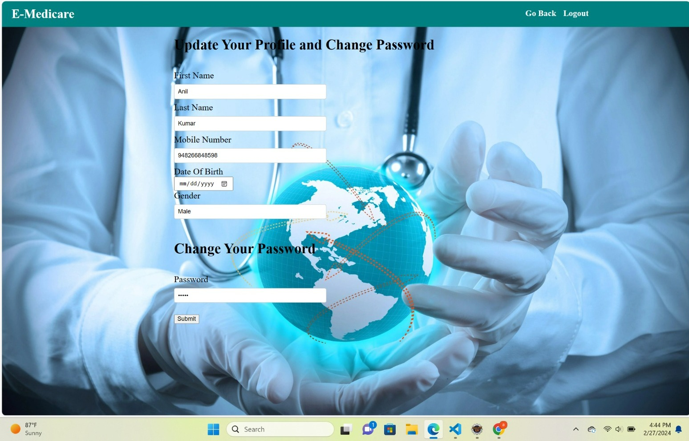
Change Password

Slide 26
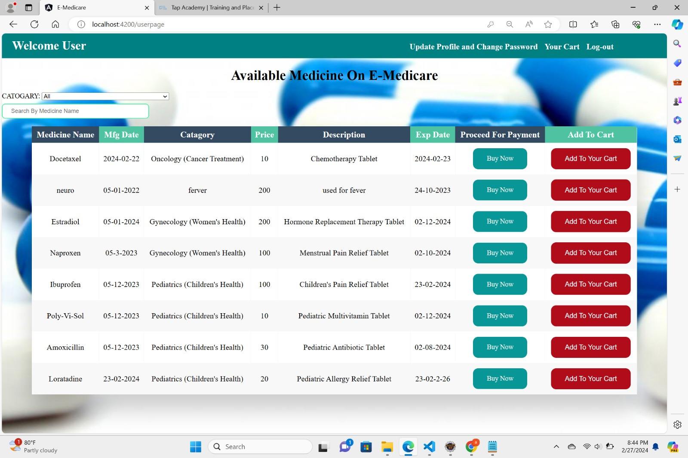
User Home Page

Slide 27
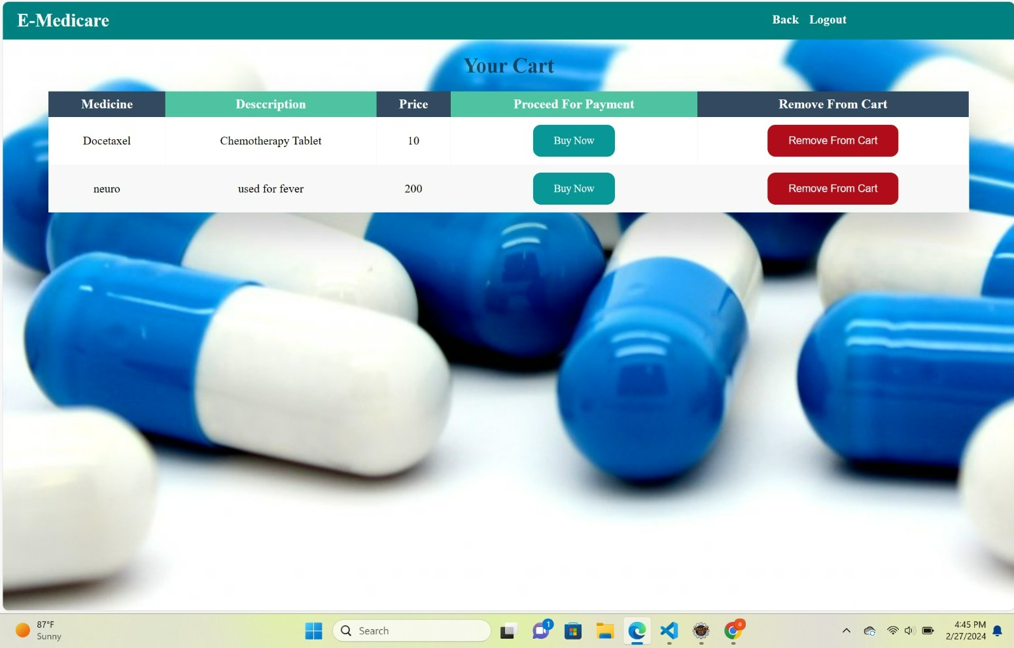
Cart of the user

Slide 28
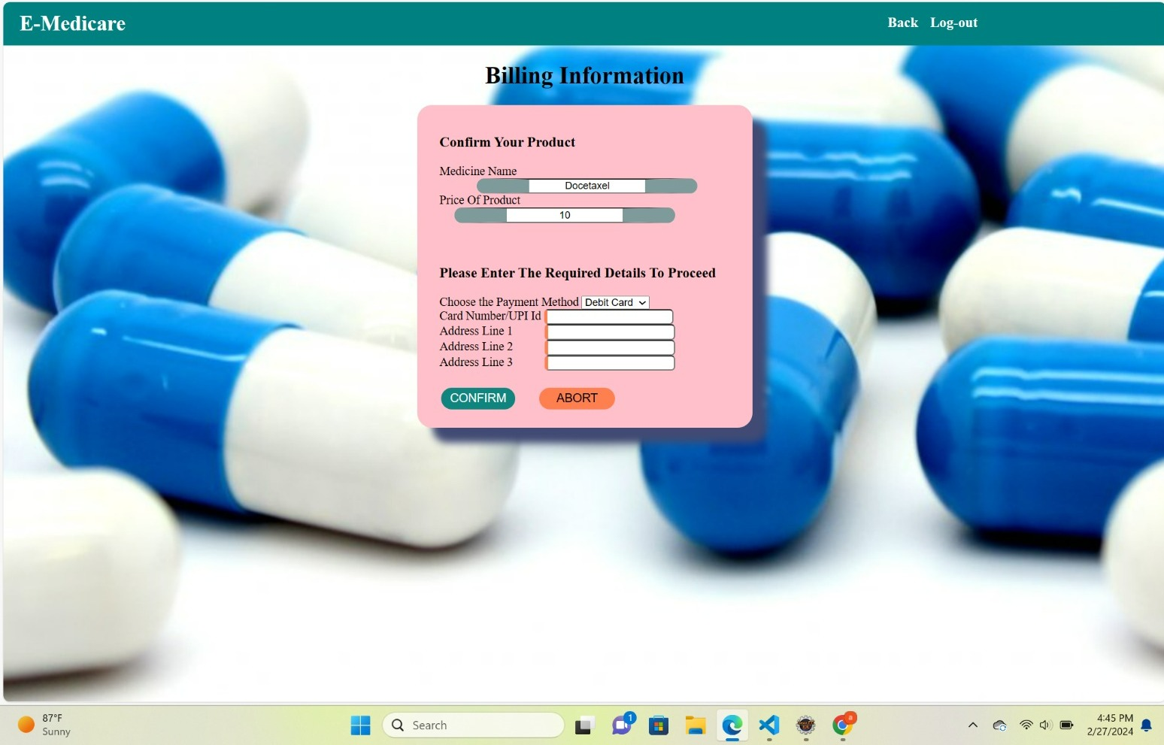
User Registration

Slide 29
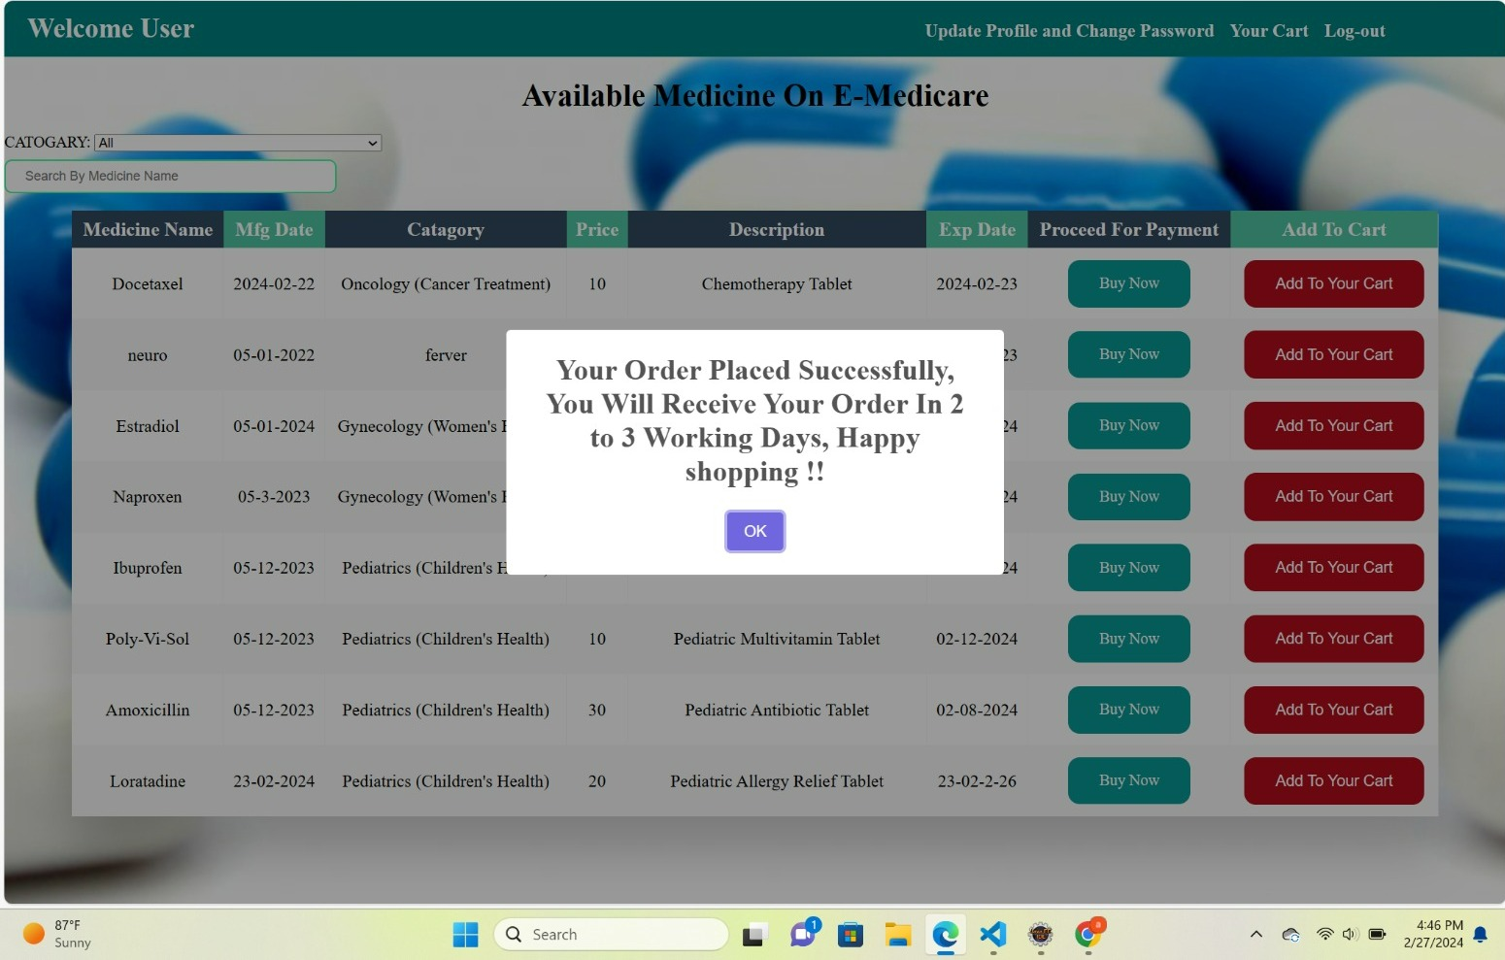
Order description

Slide 30
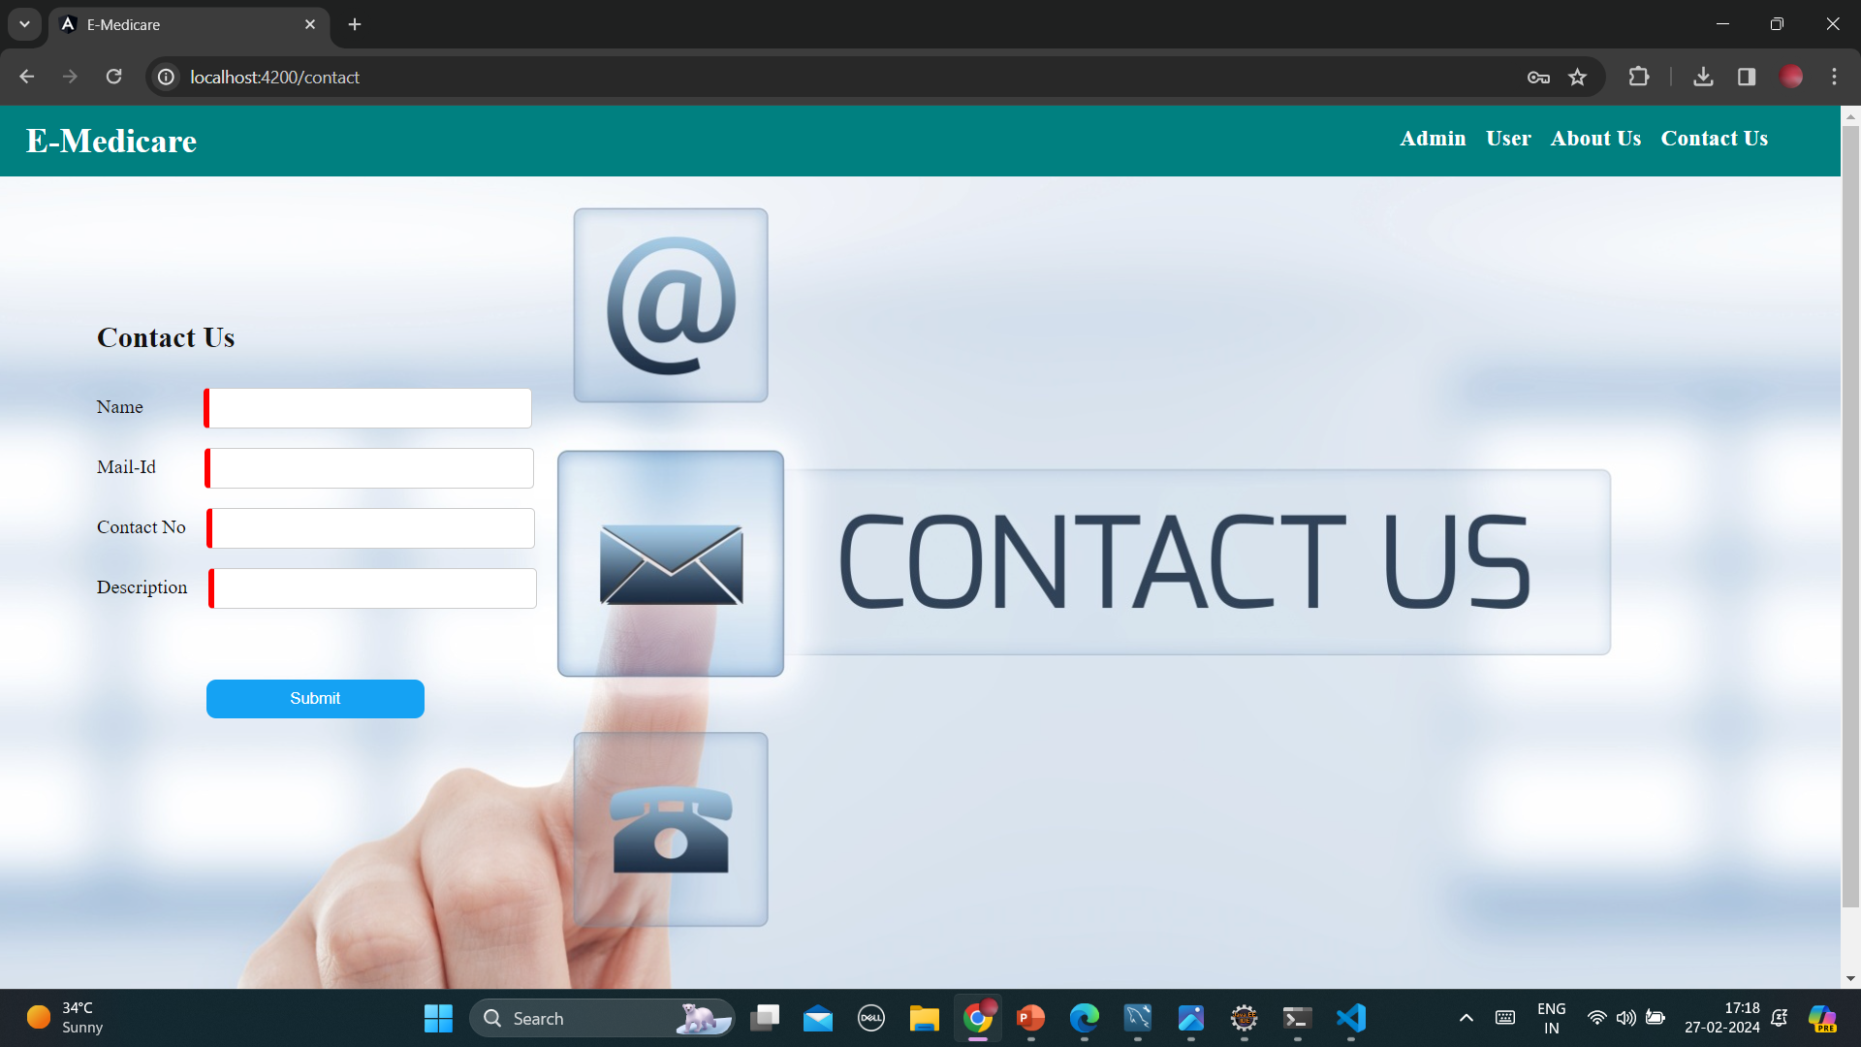
Contact Us

Slide 31
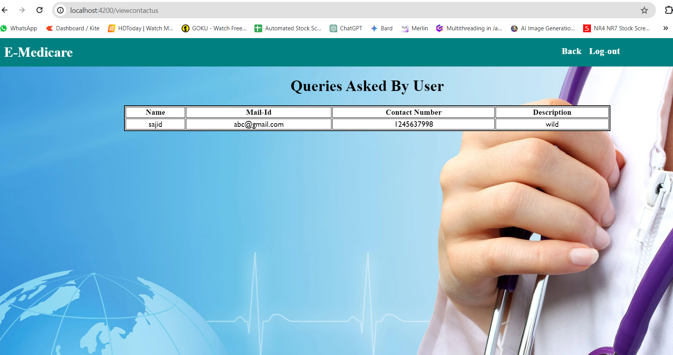
Queries

Slide 32
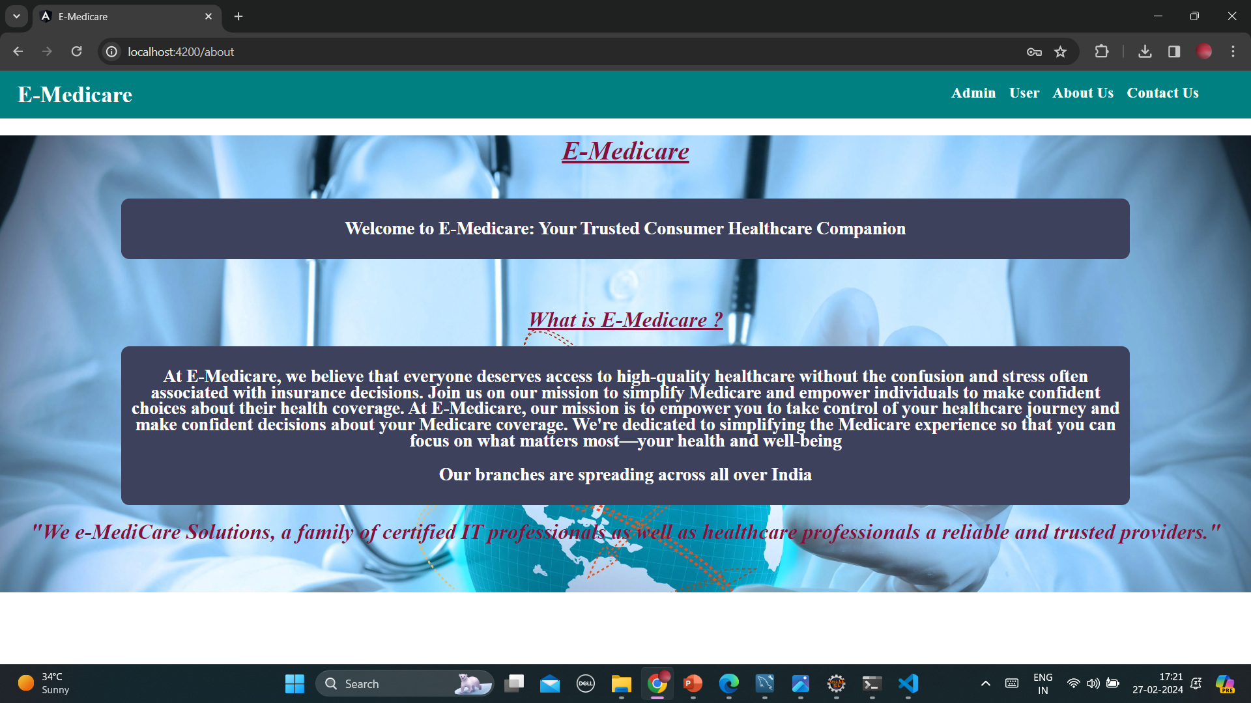
About Us

Slide 33
Conclusion
The E-Medicare application aims to provide a comprehensive solution for users to conveniently book and purchase medicines online. The development of this application involves creating a user-friendly platform that seamlessly integrates features for selecting and purchasing medications. Here's a summary of the key aspects and benefits of the E-Medicare application
User-Friendly Interface
Medicine Booking System
Personalized User Profiles
Responsive Design
Secure Online Purchases

Slide 34
Thank You !

